Slide 1


Slide 2

The Blaster Worm
Security Concepts
C and C++
The Platforms

Slide 3

August 11, 2003
Infect any unpatched system in the Internet
At least, eight million Windows infected

Slide 4

Software Companies, Security Researchers, Exploit Code Published by persons, and malicious attackers
LSD (Last Stage of Delirium) Research Group discovered a buffer overflow vulnerabilities in RPC
July 16, 2003, Microsoft released Microsoft Security Bulletin MS03-026
LSD and CERT/CC released VU#568148
July 25, 2003, Xfocus published an exploit

Slide 5

Xfocus Analyzed the microsoft patch by reverse engineering and identify the vulnerability
developed methods to attack the vulnerability
made the exploit publicly available

Slide 6
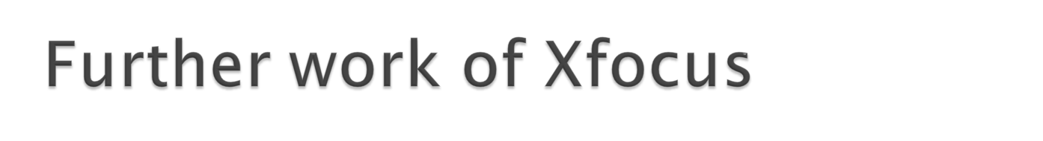
HD Moore (metaexploit founder, metasploit) improved the Xfocus code
Enable hackers to send commands through RPC
Attacks discovered on August 2
August 2-3, DefCon, worm expected
August 11, Blaster worm discovered
After 24 hours, 336,000 computers infected
100,000 systems per hour at peak

Slide 7
Exploiting a vulnerability in the DCOM RPC interface of Windows
Check if infected, and not infect the second time
If not, add to the registry key
  “windows auto update”=“msblast.exe”
  HKEY_LOCAL_MACHINE\SOFTWARE\Microsoft\Windows\CurrentVersion\Run
  the worm runs when windows starts
Generate a random IP for the next infection

Slide 8
Send data on TCP port 135 to exploit the DCOM RPC vulnerability on windows XP or Windows 2000
Listen on UDP port 69 for connections from infected computers with the DCOM RPC exploit
For a request, send the msblast.exe to the computer and execute

Slide 9
Use cmd.exe to create a backdoor remote shell process
  listen on TCP 4444
  attack can issue remote commands
Launch a denial-of-service (DOS) attack on Windows update to prevent from patch downloading
  SYN flooding port 80 of windowsupdate.com
If not infect successfully, kill svchost.exe on windows NT, 2000, XP, and 2003
  windows NT and 2000 will hang
  windows XP and 2003 will reboot

Slide 10
HRESULT GetMachineName(
WCHAR *pwszPath,
WCHAR wszMachineName[N + 1])
{
LPWSTR pwszServerName = wszMachineName;
while (*pwszPath != L'\\' )
*pwszServerName++ = *pwszPath++;
...
}

Slide 11

Security Policy
Security Flaws
Vulnerability
Exploits
Mitigations

Slide 12
Security
policy
System integrator
System administrator
Network administrator
Programmer
applied to
composed
of
composed
of
composed
of
composed
of
Source
codec
Software
Component
Program
Computer
System
Network
may
contain
may
contain
may
possess
may
possess
may
contain
Security
flaw
can lead to
Vulnerability
addressed by
resolved by
attacked by
Vulnerability analyst
Security analyst
Mitigation
Exploit
Attacker
Security researcher

Slide 13
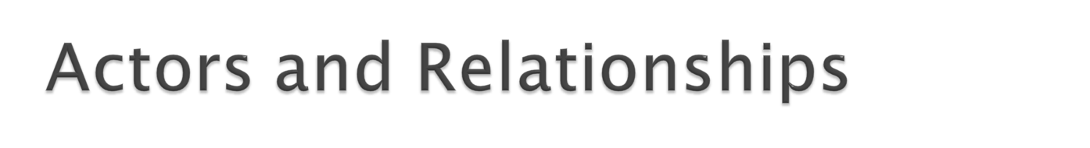
Programmer
System Integrator
System Administrators
Network Administrators
Security Analyst
Vulnerability Analyst
Security Researcher
Attacker

Slide 14

A set of rules and practices that specify or regulate how a system or organization provides security services to protect sensitive and critical system resources.

Slide 15

A Security flaw is a software defect that poses a potential security risk.

Slide 16
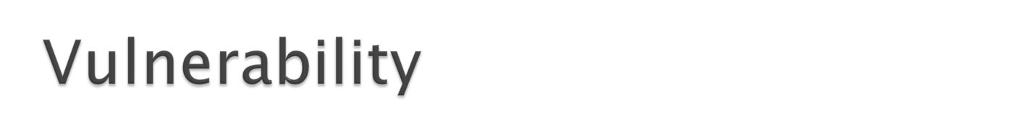
A vulnerability is a set of conditions that allows an attacker to violate an explicit or implicit security policy.
Violation of Security Policy

Slide 17
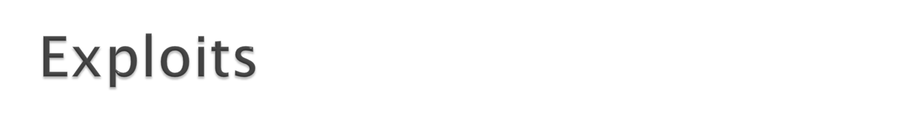
An exploit is a piece of software or technique that takes advantage of a security vulnerability to violate an explicit or implicit security policy.

Slide 18

potential defect or weakness in an information system
knowledge required to exploit the defect

Slide 19
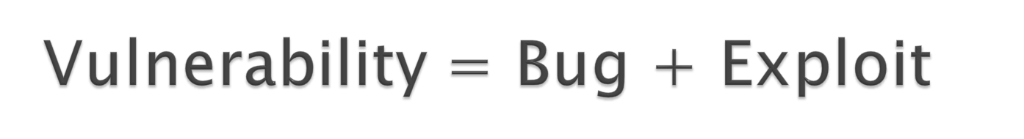
Vulnerability = Exploitable Bug
Vulnerability : Information Security Issues
Bug: Software Quality Issues
Exploit: Bridge to Connect Bug with Vulnerability
  Change Quality Issues into Security ones

Slide 20
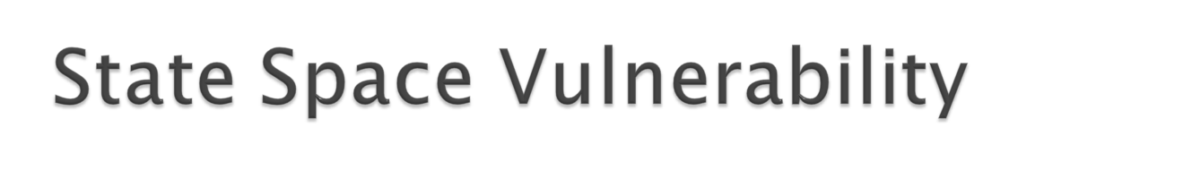
System state: current configuration of the entities in the system
Authorized or unauthorized state: given initial state using a set of state transitions defined by security policy
Vulnerability state: authorized state from which an unauthorized state can be reached using authorized state
Compromised state: the authorized state above
Attack: begins in vulnerability state

Slide 21
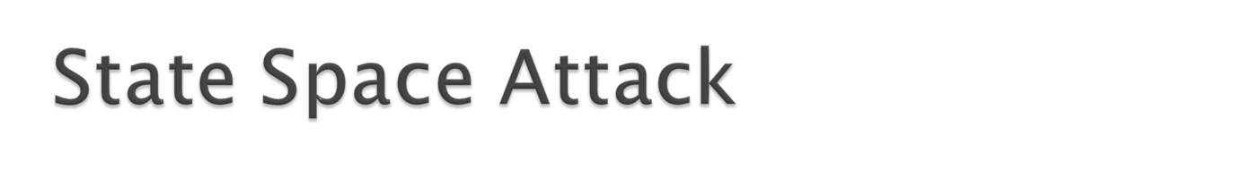
Attack
Unauthorized State
Vulnerability State
Authorized State(compromised by the attack)

Slide 22

Mitigations are methods, techniques, processes, tools, or runtime libraries that can prevent or limit exploits against vulnerabilities.

